Slide 1

Airbnb Data Analysis: Unlocking Insights for Smarter Stays
Welcome to our presentation on Airbnb Data Analysis. We'll explore how data can inform better decisions for everyone in the Airbnb ecosystem.
Team Name : TREND BREAKERS
Gaurav Kumar (23SCSE1420171)
Akshat Gupta (23SCSE1420029)
Avadhesh Kumar Bind (23SCSE1410248)
Nitin Yadav (23SCSE1010433)

Slide 2






Introduction:
Decoding the Airbnb Landscape
Global Reach
Over 1 billion guest arrivals worldwide (2008-2022)
Purpose
Extract actionable insights from raw data
Goals
Understand market dynamics, identify trends, inform strategy
Data Source
Publicly available Airbnb datasets

Slide 3
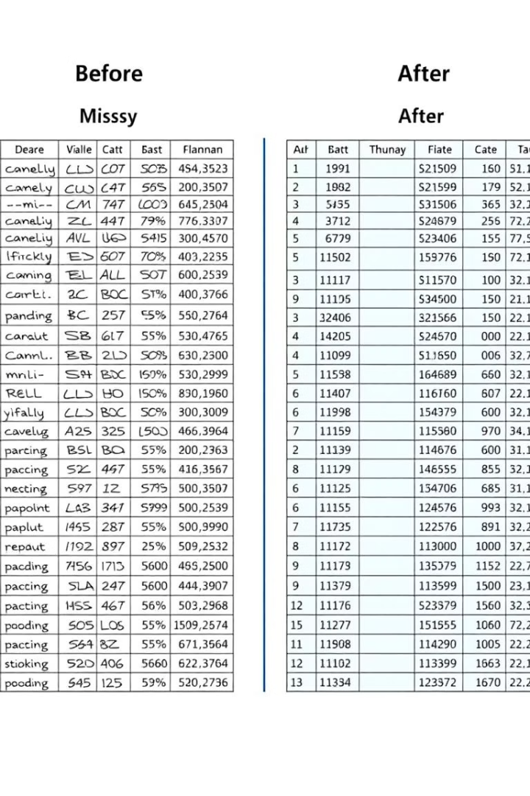
Data Integrity & Consistency: Taming the Data Beast
Handle Missing Values
Impute for numerical, 'N/A' for categorical, drop critical rows
Standardize Text
Clean special characters, trim whitespace, convert to lowercase
Verify Data Types
Ensure price is numerical using Pandas or SQL

Slide 4
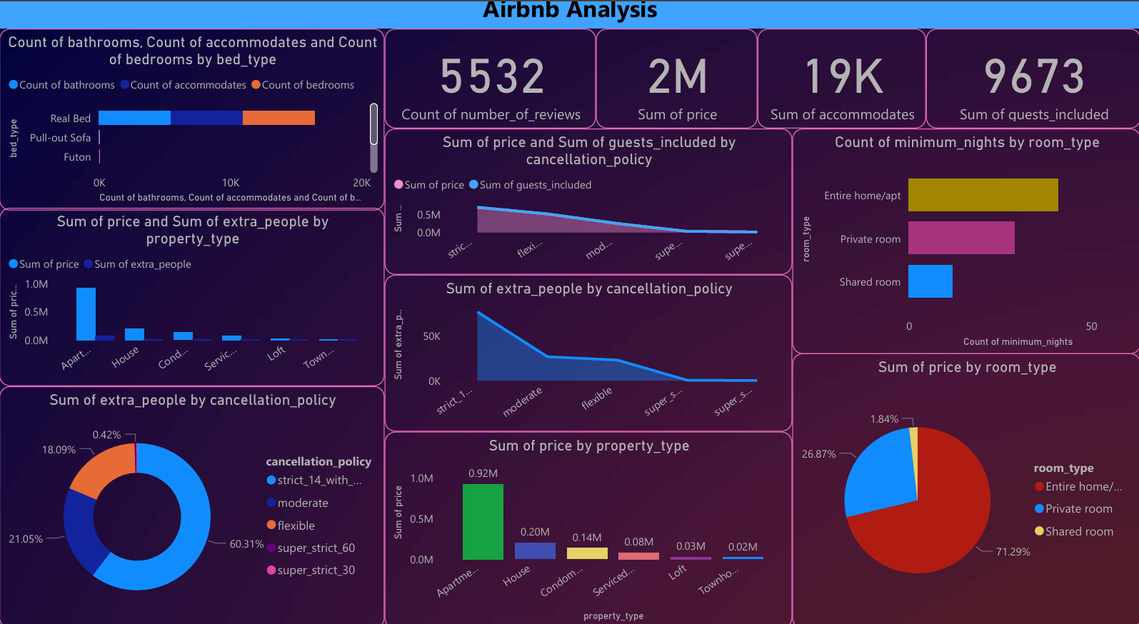
Summary Statistics & Insights:

Slide 5




Patterns, Trends & Anomalies: Spotting the Unexpected
Demand for Entire Homes
Amenities Growth
Increasing preference over private rooms
Increase in pet-friendly, Wi-Fi listings
Seasonal Price Fluctuations
Price Anomalies
Unusually low prices compared to similar properties
Higher prices during summer and holidays
2
3
1
4

Slide 6
Outliers & Data Transformations:
Dealing with the Extremes
Outlier Identification
Handling Methods
Box plots reveal extreme values
Trimming removes values beyond thresholds
Scatter plots highlight unusual points
Winsorizing replaces extremes
Log transformation reduces skewness
Identifying outliers with box plots and scatter plots, then applying trimming, winsorizing, or log transformations, helps normalize data for accurate analysis.

Slide 7

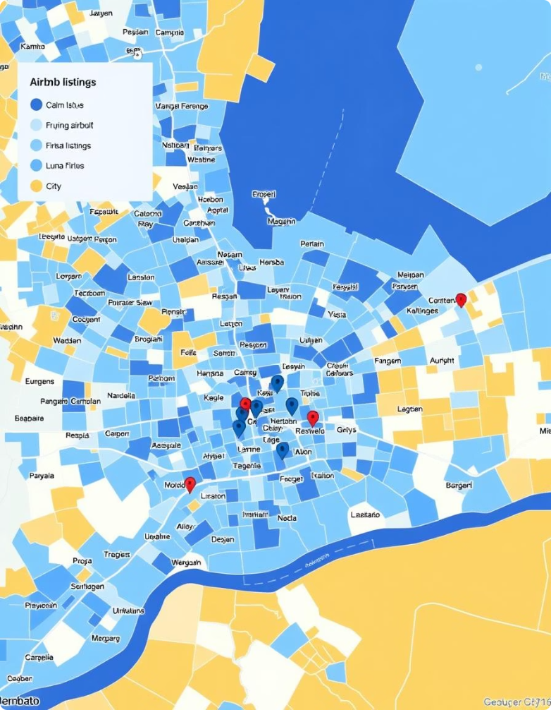
Visual Key Findings:
Initial Insights
Listing Density Heatmap
Correlation Matrix
Shows relationships between price, reviews, and other variables
Visualizes concentration of listings by neighborhood
Amenities Word Cloud
Interactive Price Map
Highlights frequently offered amenities in listings
Allows exploration of price distribution across locations

Slide 8








Conclusion:
Data-Driven Decisions for the Airbnb Ecosystem
Key Findings
Implications
Summarizes insights from the analysis
Guides hosts, guests, and Airbnb platform decisions
Future Research
Further Analysis
Explore demographics and tourism data
Sentiment, predictive pricing, real-time demand

Slide 9
THANK YOU…

